Slide 1
Real Time Android Pothole Detection Application
By: VARSHINI 2101CS55
UNDER THE GUIDANCE OF: dr.jimson mathew
DEPT OF COMPUTER SCIENCE AND ENGG,IIT PATNa

Slide 2
Objective:
The primary objective of this presentation is to introduce and demonstrate the utilization of YOLOv5, an advanced object detection algorithm, for the detection of potholes on road surfaces. And Implementing it in a real time android application.
Improve Road Safety: By accurately detecting potholes, the project contributes to enhancing road safety for drivers, cyclists, and pedestrians.
Optimize Infrastructure Maintenance: Efficient pothole detection enables timely repairs, minimizing road damage and reducing maintenance costs for transportation authorities.
Enhance Transportation Efficiency: Identifying and addressing potholes promptly ensures smoother and more reliable transportation networks, improving overall efficiency for commuters and businesses.
Showcase Technological Innovation: By leveraging state-of-the-art object detection techniques, the project highlights advancements in technology for addressing real-world challenges in infrastructure management and urban development.

Slide 3
MODEL ARCHITECTURE
Backbone (Feature Extractor):
------> Divides the input image into different scales, akin to navigating a city map.
------>Extracts important visual features such as edges, textures, and shapes.
------>Generates feature maps at various scales to capture details at different levels.
Head (Feature Processor and Detector):
------> Combines and processes feature maps from the backbone,similar to analyzing and interpreting clues.
------> Refines and enhances the information to improve detection accuracy.
------> Performs object detection to predict the presence and locations of potholes in the image.
In summary, the backbone sets the stage by extracting visual features, while the head further processes and interprets these features to accurately detect potholes in the input image.

Slide 4
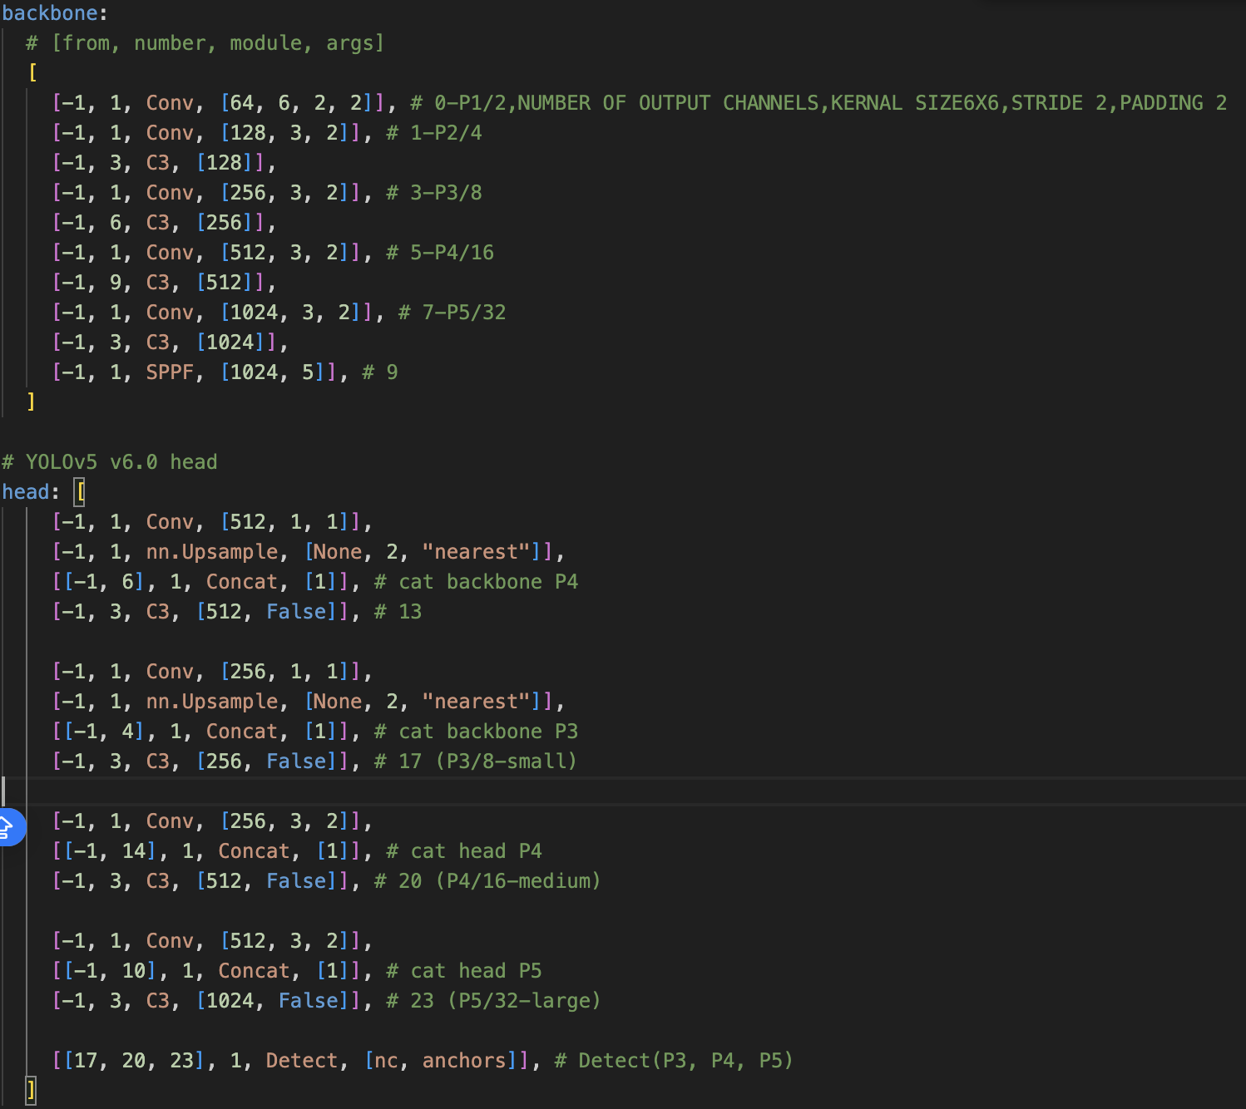

Slide 5
DATASET:
The dataset utilized in this project comprises annotated images of road surfaces containing potholes.
Collected Some of the data for training from the roads connecting bihta to IIT Patna
Training Images: A set of 1265 high-resolution images used for training the YOLOv5 model.
Validation Images: Consisting of 401 images, the validation set is used to evaluate the model's performance during training .
Test Images: The dataset includes 118 test images, serving as a final evaluation benchmark for the trained model. These images are not used during training or validation, providing an independent assessment of the model's detection accuracy.

Slide 6
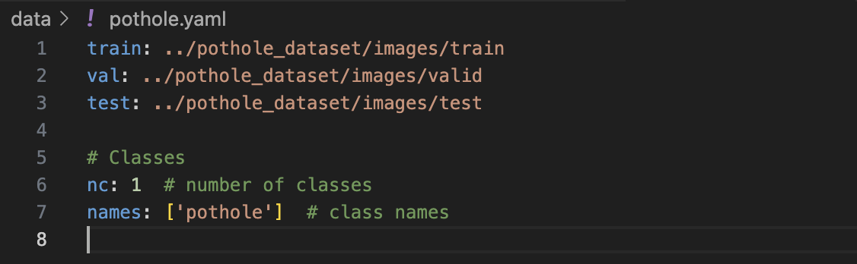
Dataset Configuration
The YAML file defines the paths to training, validation, and test datasets for pothole detection.
By utilizing this dataset configuration, we ensure that the training, validation, and testing data are correctly specified, along with the class information required for the pothole detection task.

Slide 7
TRAINING THE DATASET :
Utilization of GPU for faster training: Increased computational power and reduced training time.
python train.py --data ./data/pothole.yaml --epochs 300 --weights '' --cfg yolov5n.yaml --batch-size 128
Got dependency issues and outdated framework errors encountered while training the dataset
Identified and resolved dependency conflicts by ensuring that all required libraries and packages are installed and up-to-date. This involved checking the versions of Python
Updated the YOLOv5 framework and related dependencies to the latest versions available
Ran till 154 epochs

Slide 8
AFTER TRAINING
After training, the model produces weights files such as best.pt and last.pt.
best.pt: This file contains the weights corresponding to the model's best performance on the validation dataset during training.(ACCURACY)
This file contains the weights of the model after the final epoch of training. It represents the latest state of the model at the end of the training process. While last.pt may not necessarily correspond to the model's best performance, it still reflects the final training state and can be useful.

Slide 9
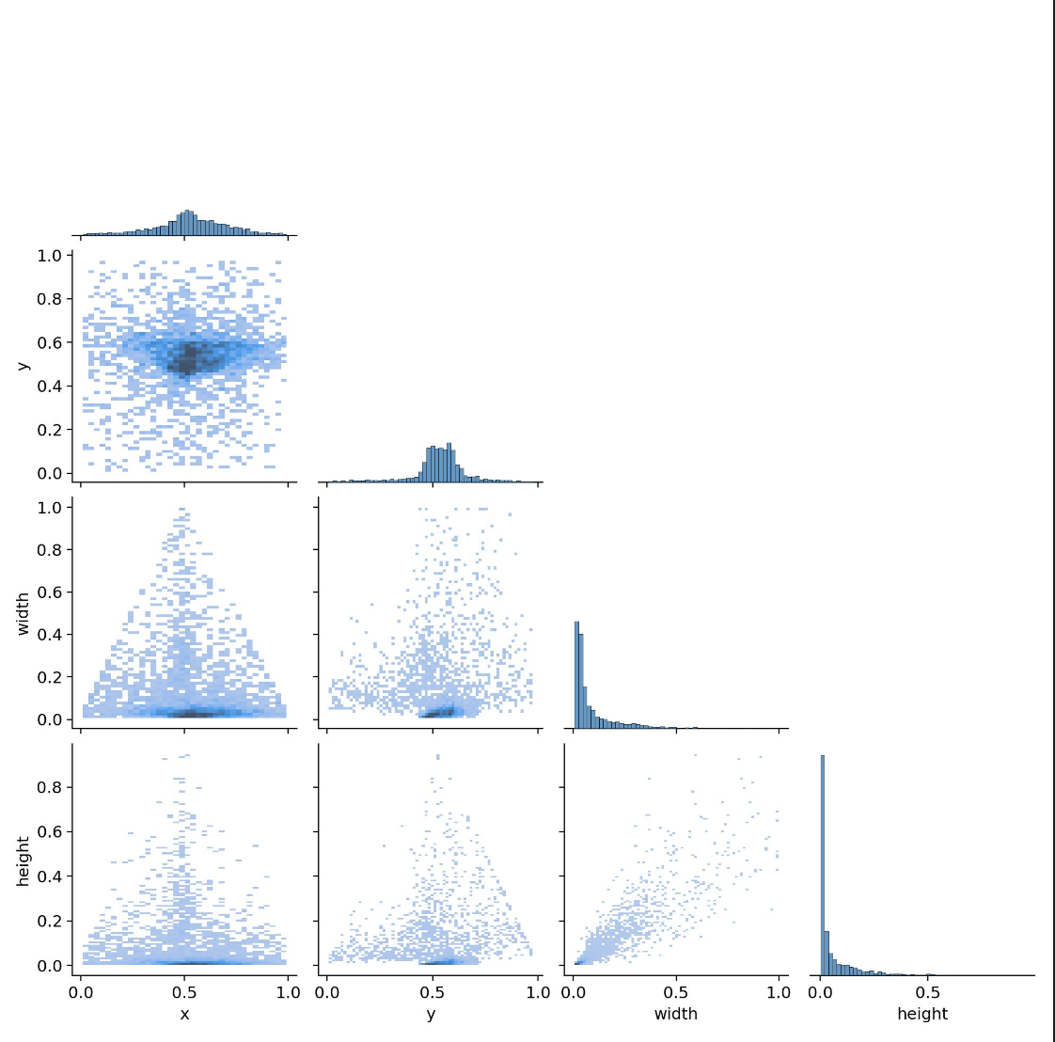
SOME DATA AFTER TRAINING PROCESS:
The "labels_correlogram.jpg" file likely displays a correlogram, which is a graphical representation of correlations between different labels or categories within a dataset.
The dark and light-colored points on the graph represent the strength of correlation between these features.
Darker points indicate stronger positive correlations, suggesting that changes in one feature correspond closely with changes in another feature.
Lighter points indicate weaker or negative correlations, implying less direct relationships between the features.
This analysis helps understand how different aspects of pothole features relate to each other, which can inform the development of more accurate pothole detection algorithms.
The height, width, and spatial extent

Slide 10
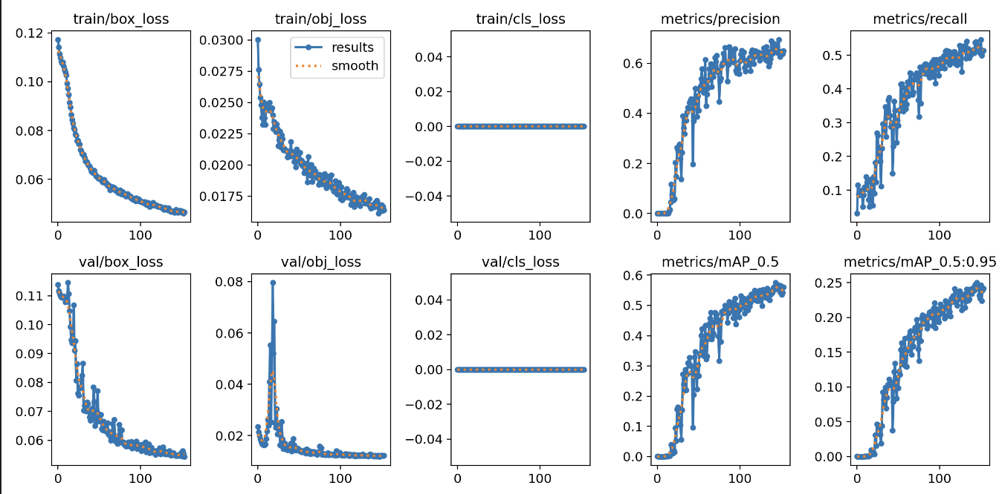
Results of training validation in terms of bounding box, objectness, and classifcation for the proposed model

Slide 11
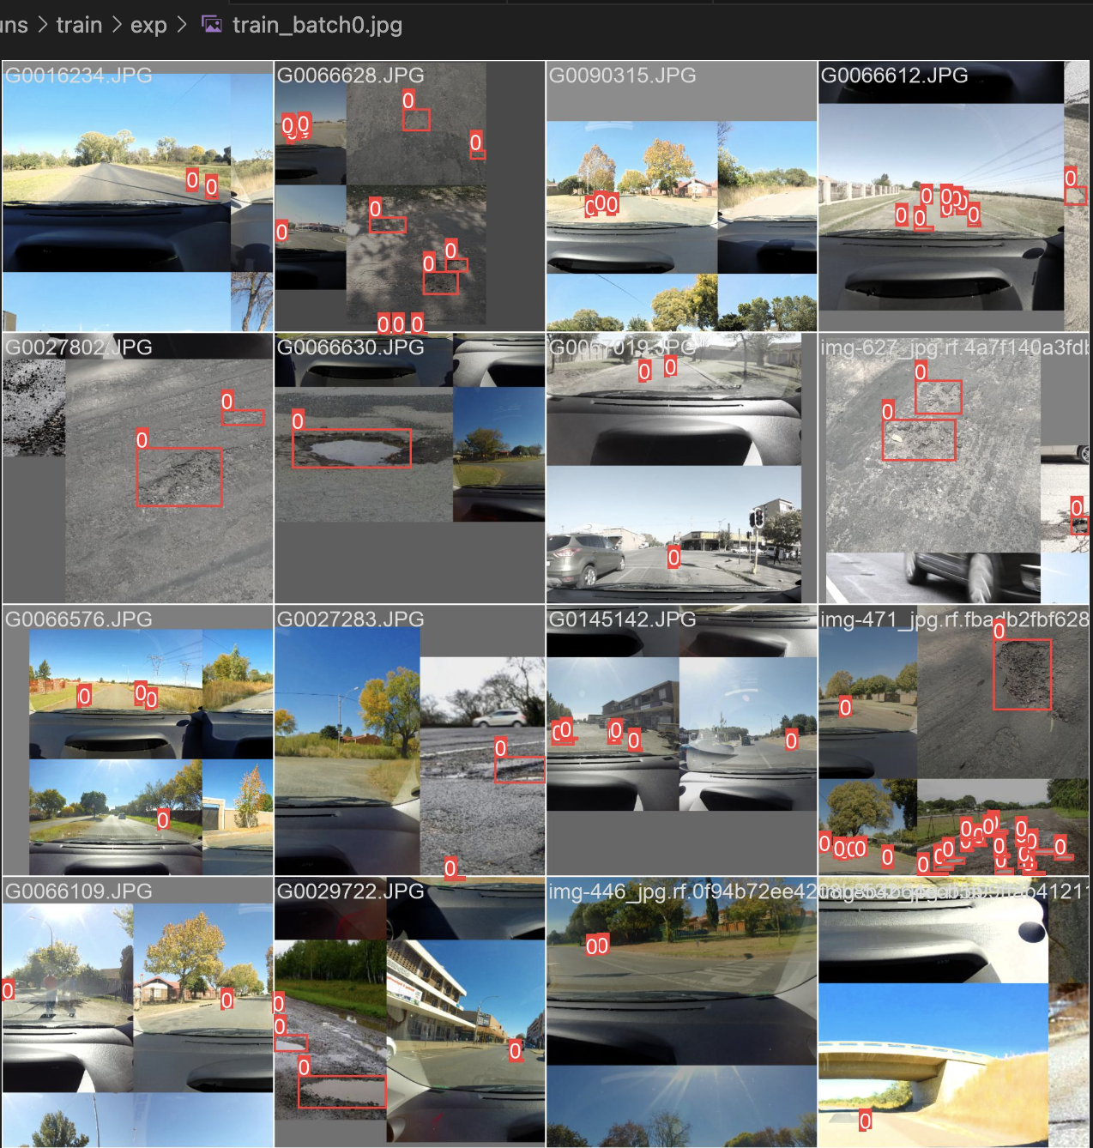
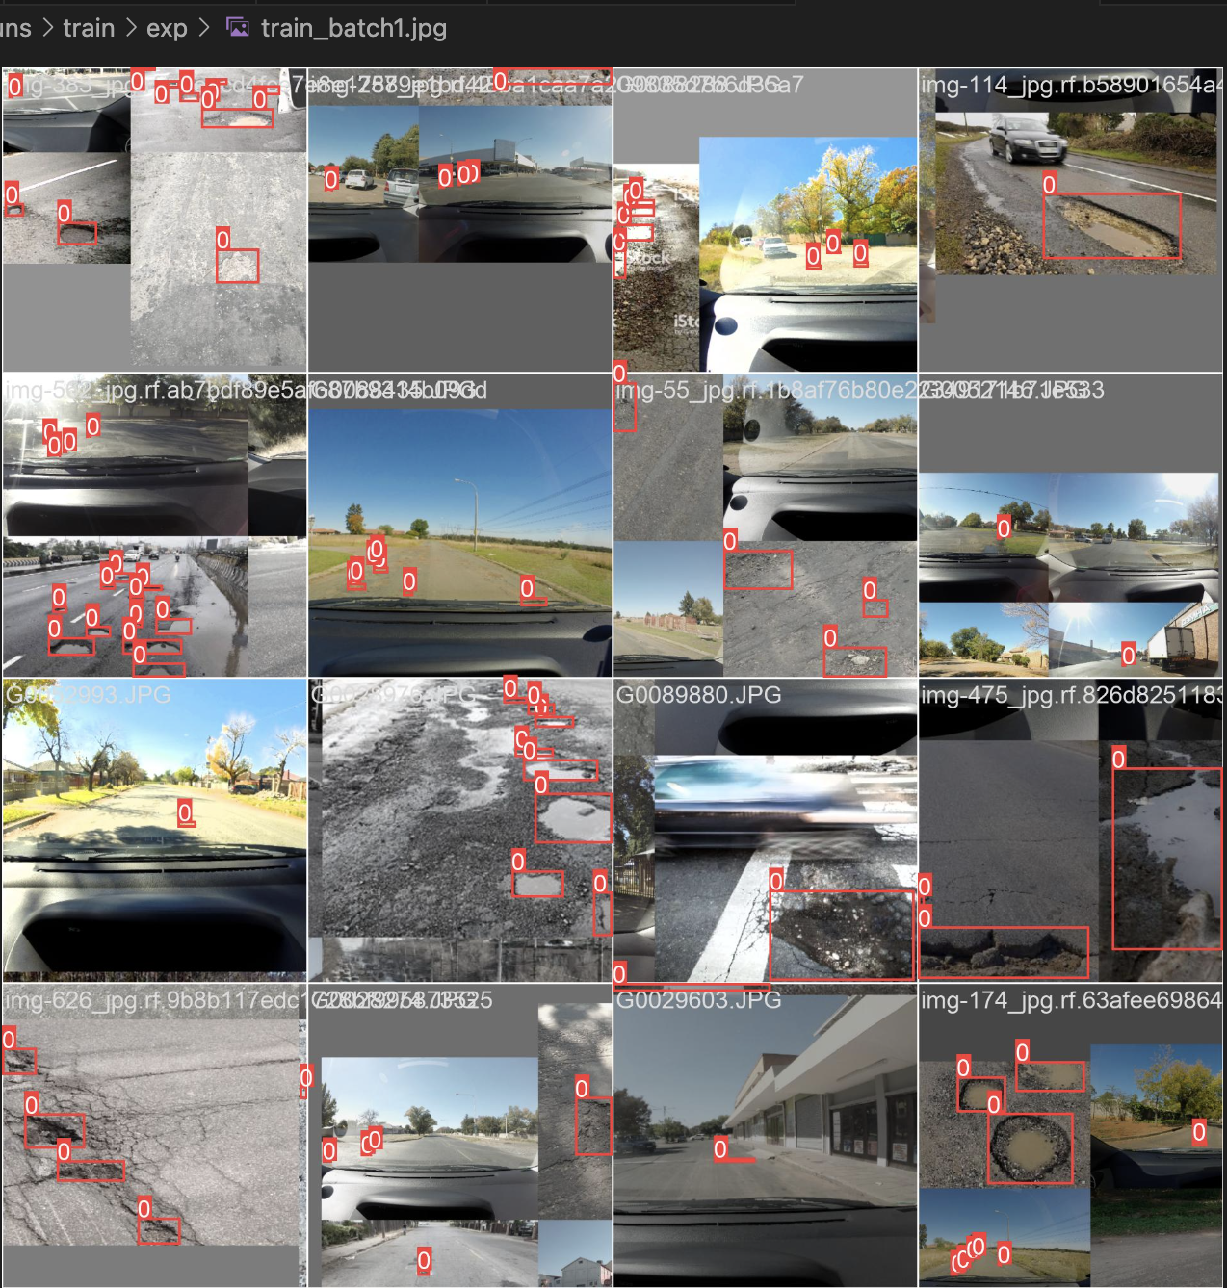
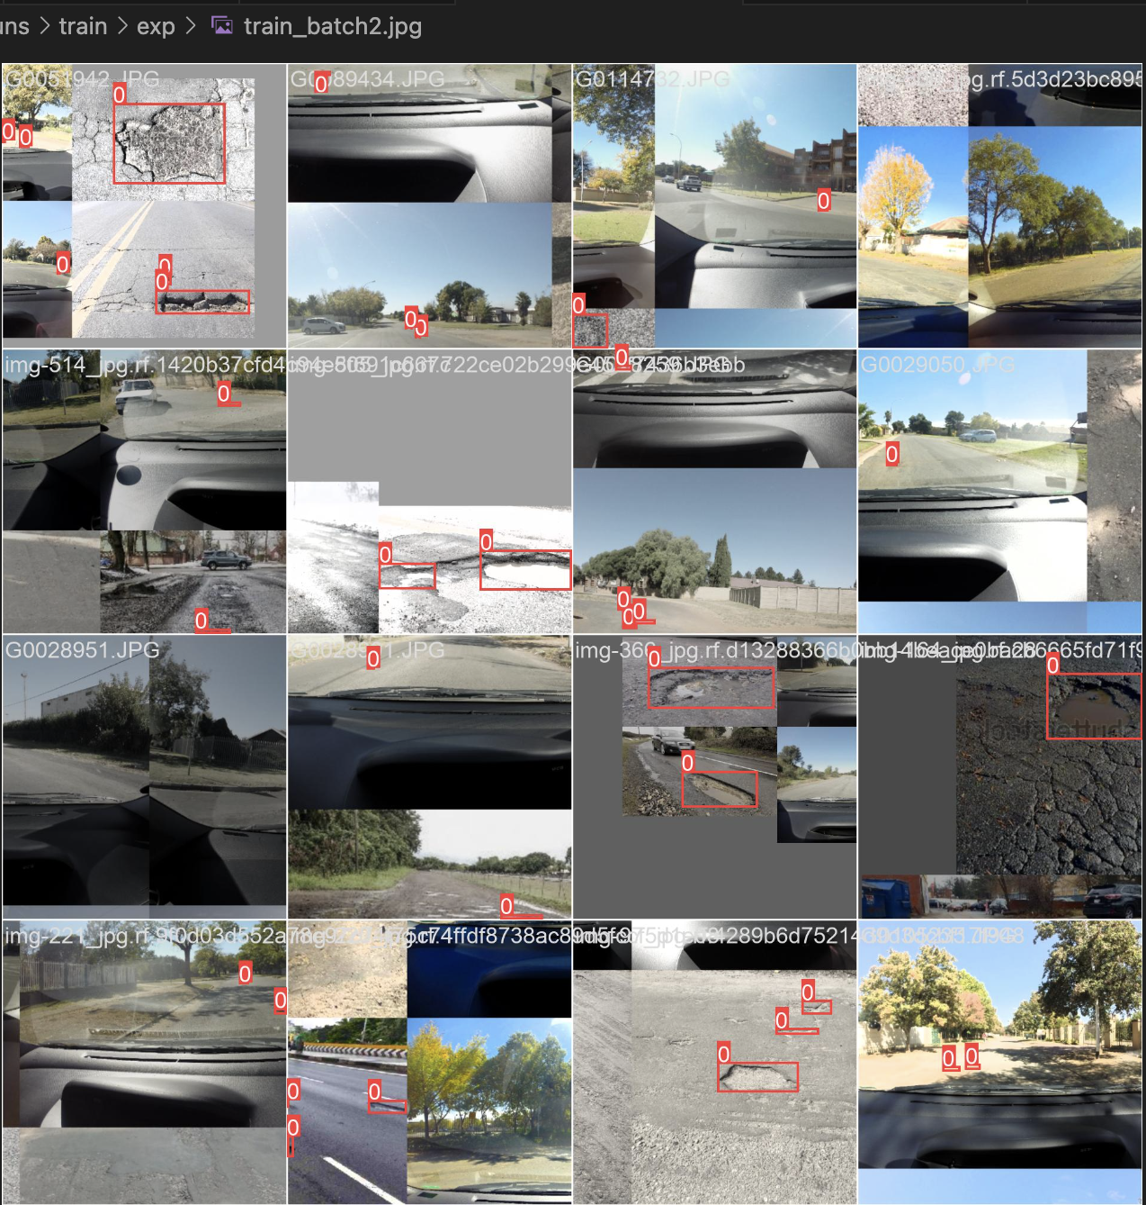
Results after exp1
Results after exp1
Results after exp1

Slide 12
this command loads the trained YOLOv5 model with the specified weights and uses it to make predictions on the provided test image, identifying and localizing potholes within the image.
python detect.py --weights ./runs/train/exp/weights/best.pt --source ./pothole_dataset/images/test/G0010760.JPG
python detect.py --weights yolov5s.pt --source 0 # webcam
img.jpg # image
vid.mp4 # video
screen # screenshot
path/ # directory
list.txt # list of images
list.streams # list of streams
'path/*.jpg' # glob
'https://youtu.be/LNwODJXcvt4' # YouTube
'rtsp://example.com/media.mp4' # RTSP, RTMP, HTTP stream

Slide 13
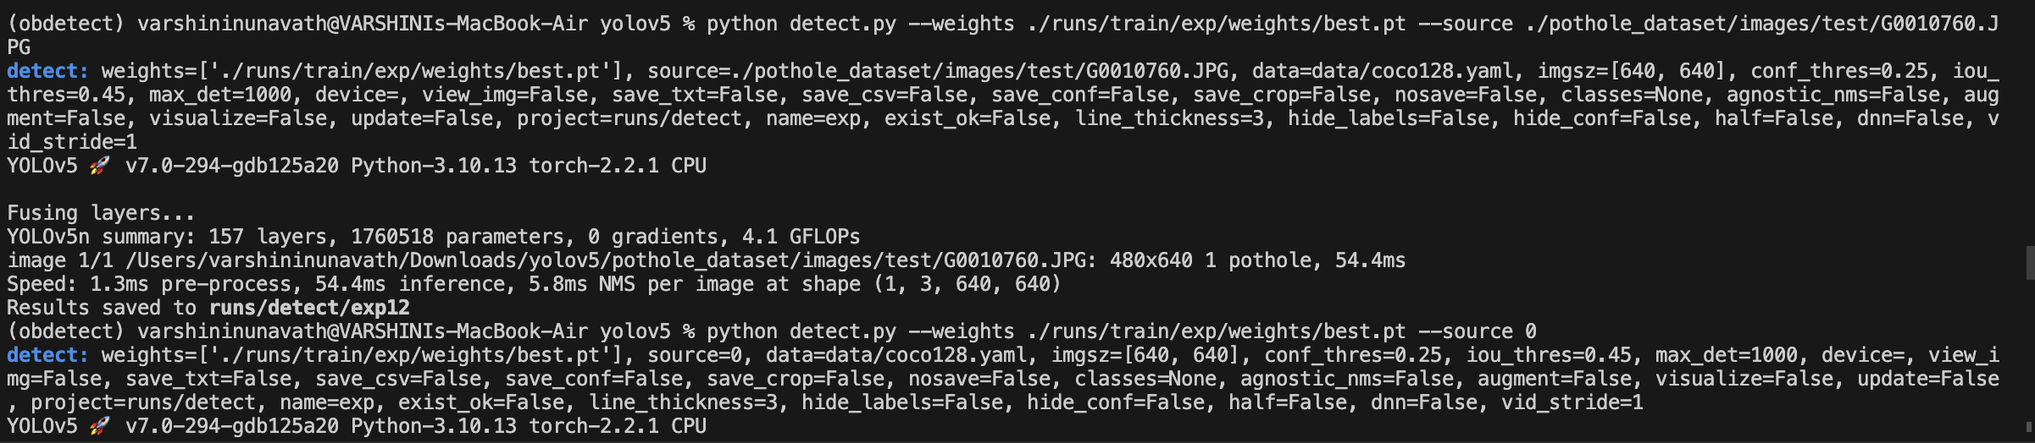
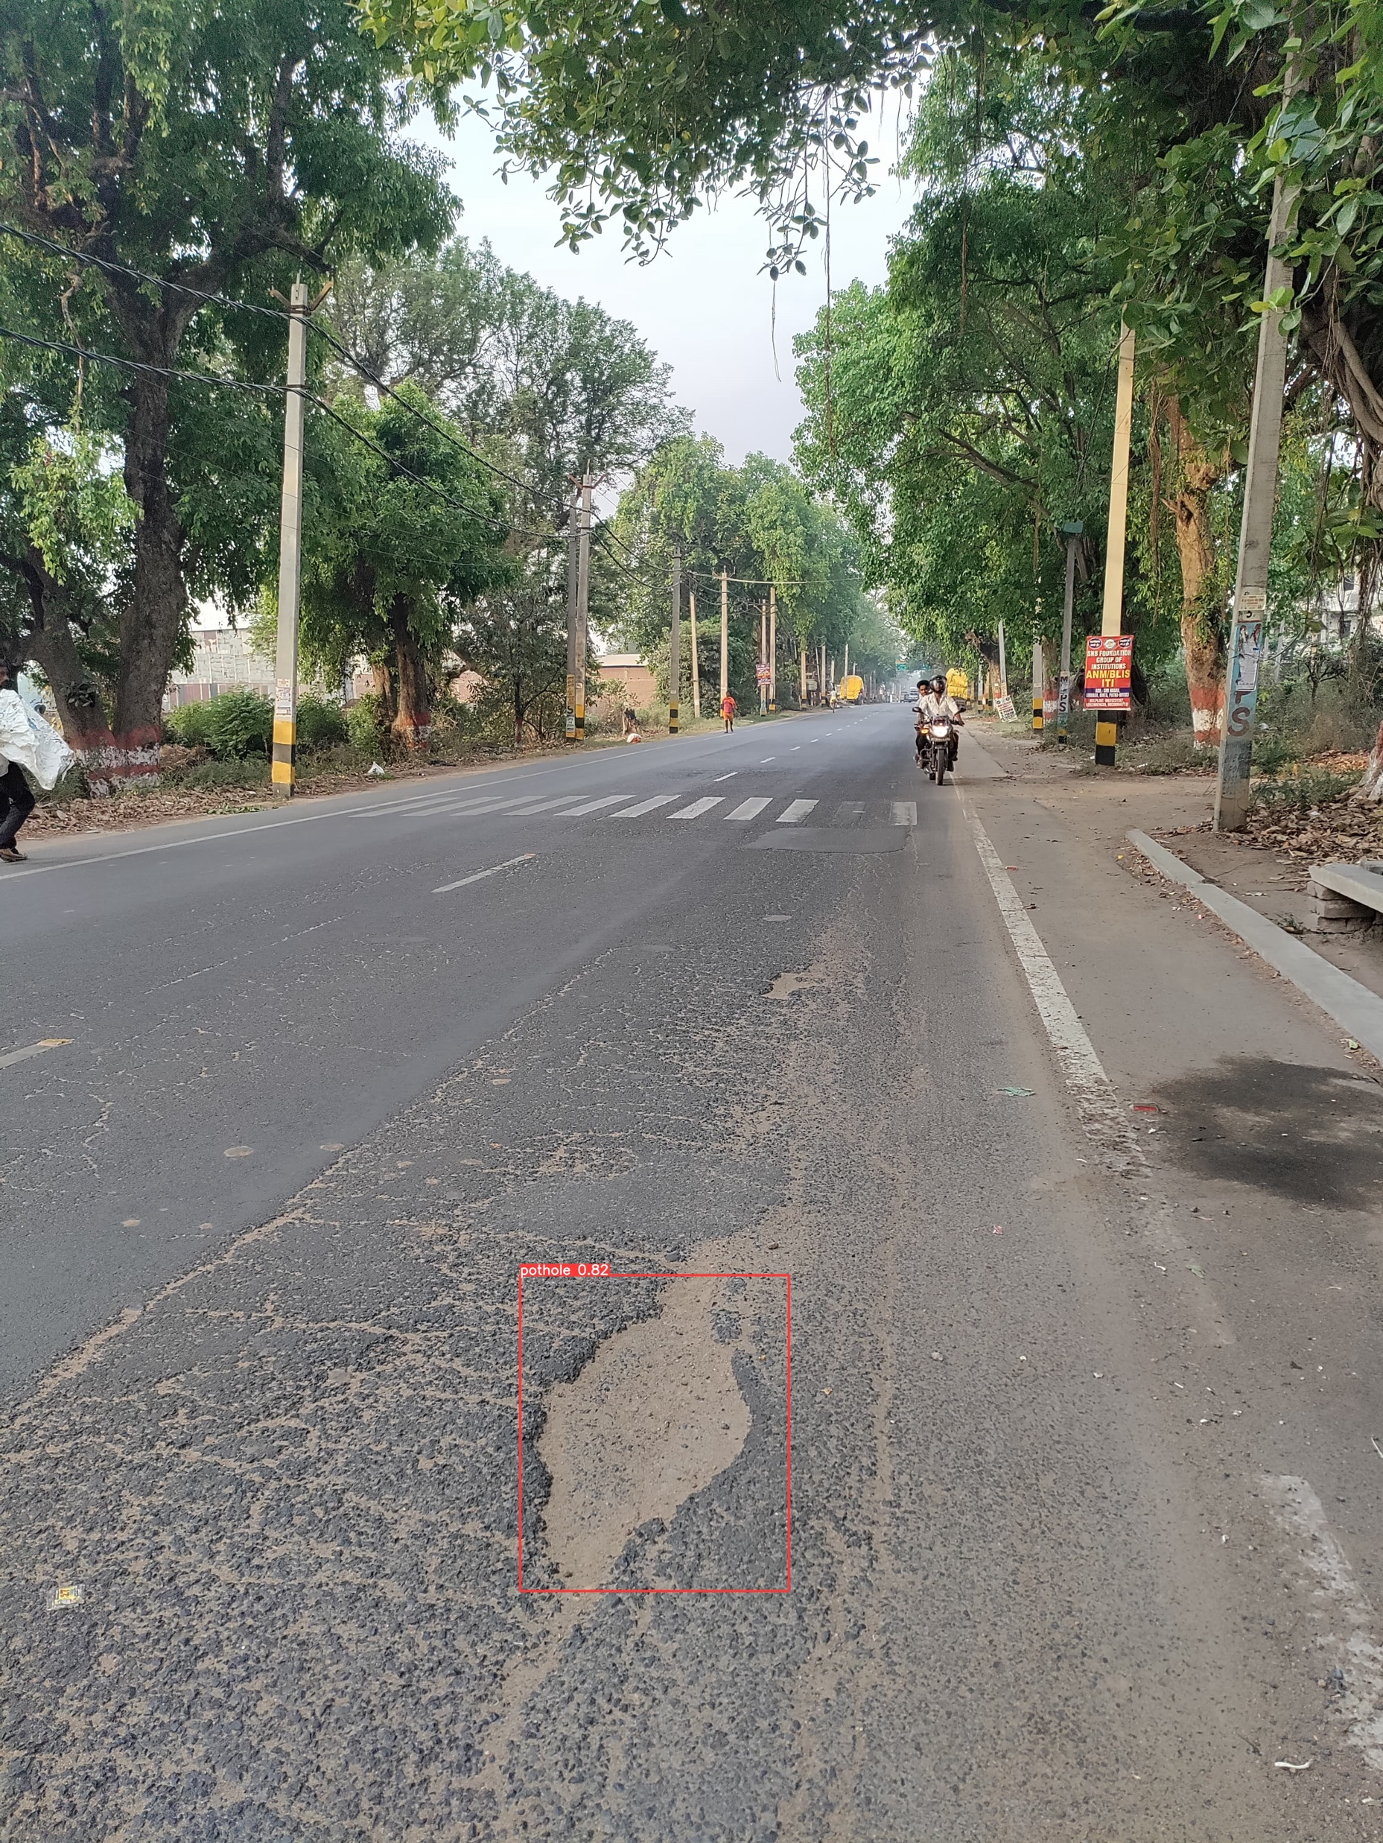
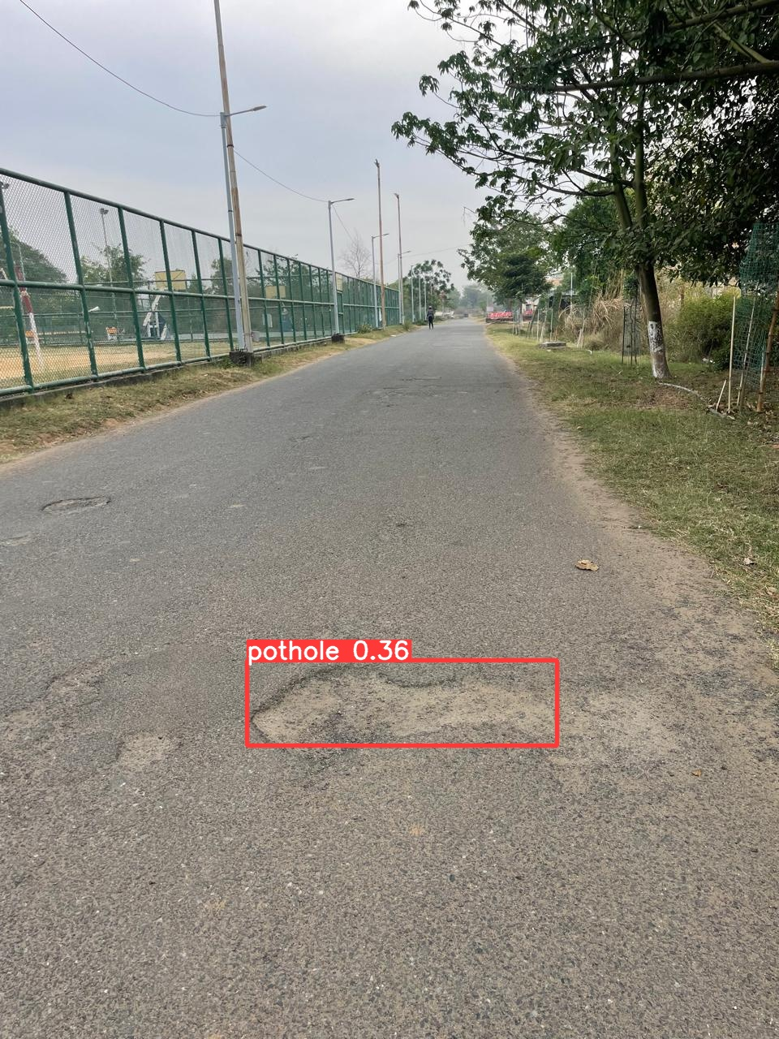

Slide 14
Android real time application for detecting potholes
TensorFlow Lite conversion:
--->Utilized best.pt file for highest accuracy on validation dataset.
--->Converted model to TensorFlow Lite (.tflite) for mobile compatibility.
--->Integrated TensorFlow Lite model into Android Studio project.

Slide 15
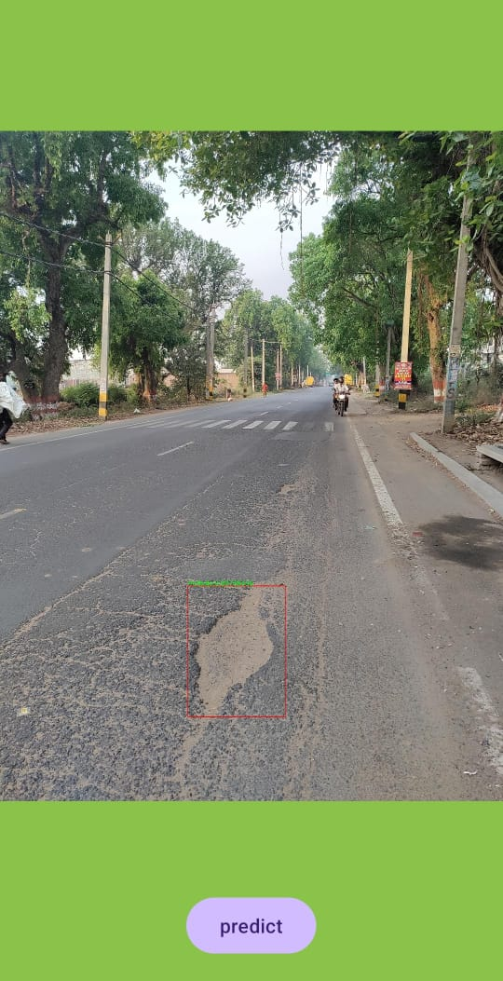
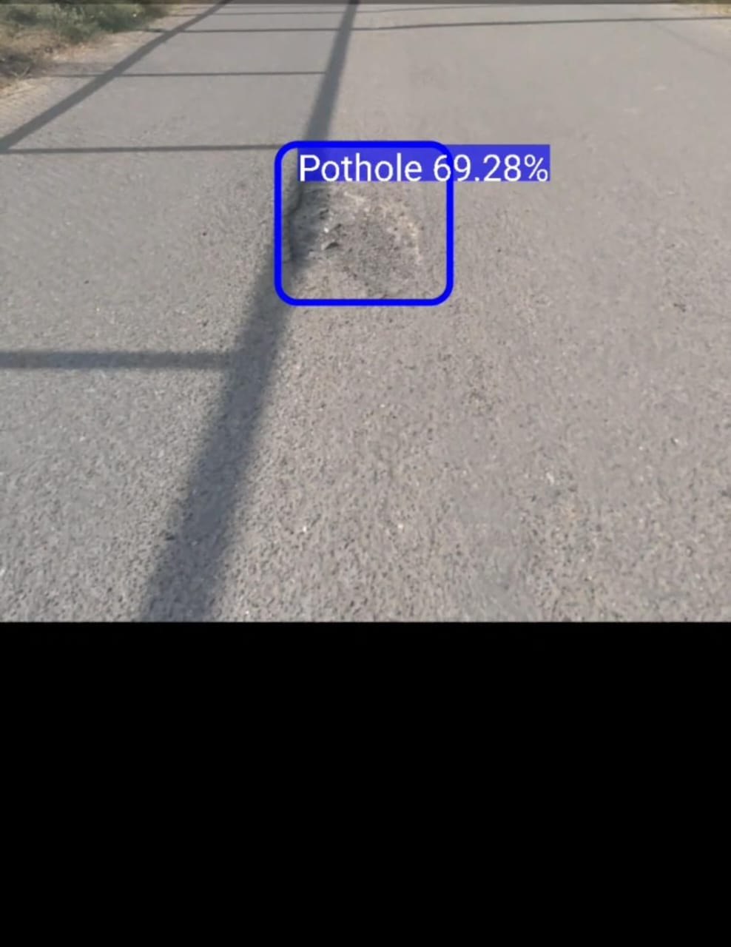
This is a part of screenshot during real time
This is how it captures an image from gallery in app.
Full video in the video file

Slide 16
THANKYOU
Varshini 2101CS55

